Slide 1
Iteration 4 -
ICS 499
Abdul Hazari, Ans Khan, Muhammad Sohail

Slide 2
Transaction for Non-Profit Organization

Slide 3
Iteration 4
Introduction
Vision and Scope
Business Value
Feasibility Studies
Software Development Methodology
Proposed System Functionalities
Use case diagram
Project log
Hardware and Software Requirements
Project plan

Slide 4
Introduction
This project is for senior students of Bachelor of Science in Computer Science and Information Technology by Ans Khan, Abdul Hazari and Muhammad Sohail. The project is done for the Metropolitan State University’s class ICS 499-01 which was taught by Dr Ismail Bile Ismail.
The system that was created for this project was to provide a user friendly interface to make donations for any non-profit organization. The system concerns with an application that does transaction management for any non-profit organisation, that gets funding from individuals.
Any non-profit organisation can be chosen and money can be transferred to that specific organisation or NGO, and the method of the transaction can only be processed by adding or selecting credit cards

Slide 5
Vision
To provide an easy to use application that can help in transaction management of individuals for various organisations. With this application in hand there is no use for individuals to go on to different websites of organisations and make donations.
This application will be served as a common platform for individuals to make donations to various organisations..

Slide 6
Scope
The donors will be able to register and login to the website to make donations and will be able to manage their accounts as well as see the donations they have made to their choice of the non-profit organization.
The donors or users will add their credit cards, organisation name which they want to donate to and the amount to be donated so that they can make the transaction to the organization.

Slide 7
Business Value
It will be beneficial for the donor and the organizations that it will save them as it will serve as the only website for different organizations to accept donations from the donors. It will save time for the donors as they don't have to spend looking for the website and it will be cost efficient

Slide 8
Feasibility Studies
The application will be web-based for the users. We are planning to have a public survey which will help us include more functionality to this application and make is better and easy to use.

Slide 9
Software Development Methodologies and Hardware
10.1 Software Requirements
Operating System: Windows 7, 8 10 or Mac
Frond End: HTML, PHP, CSS
Back End: PHP, Database
10.2 Hardware Requirements
Laptops, PCs and Phones

Slide 10
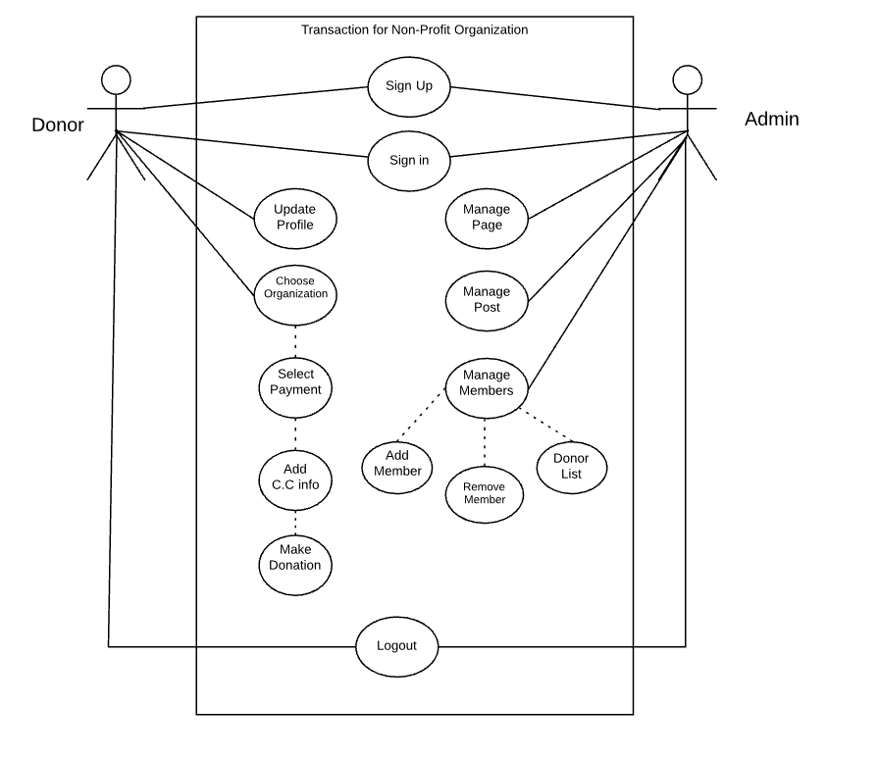
Use Case Diagram

Slide 11
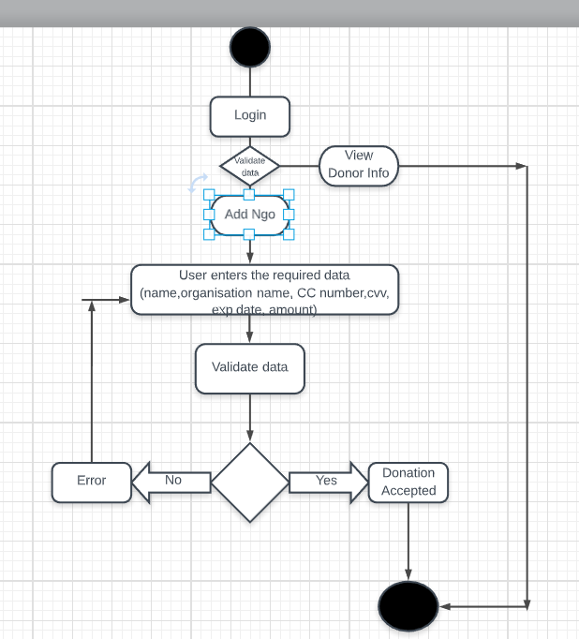
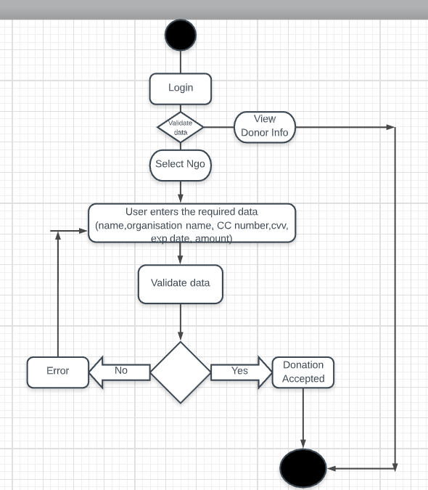
Activity Diagram

Slide 12
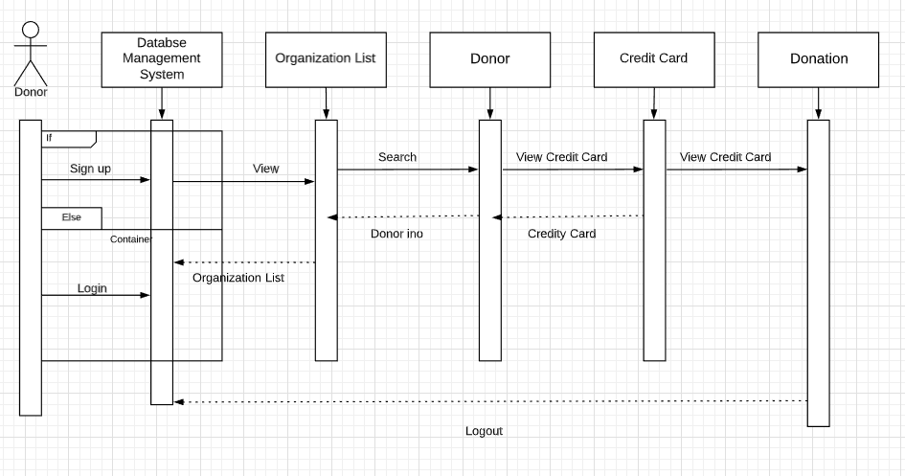
Sequence Diagram - Donor

Slide 13
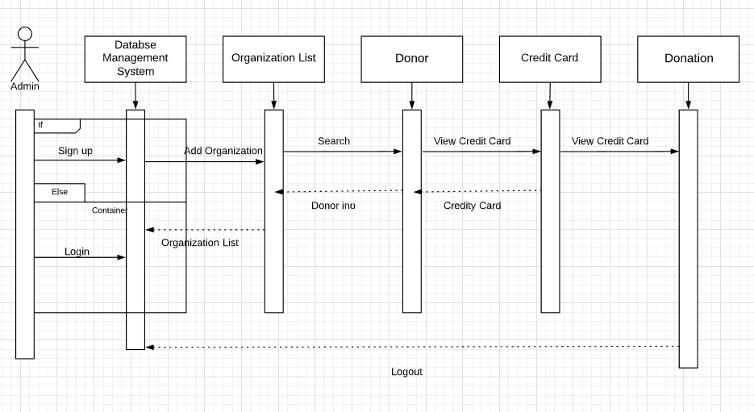
Sequence Diagram - Admin

Slide 14
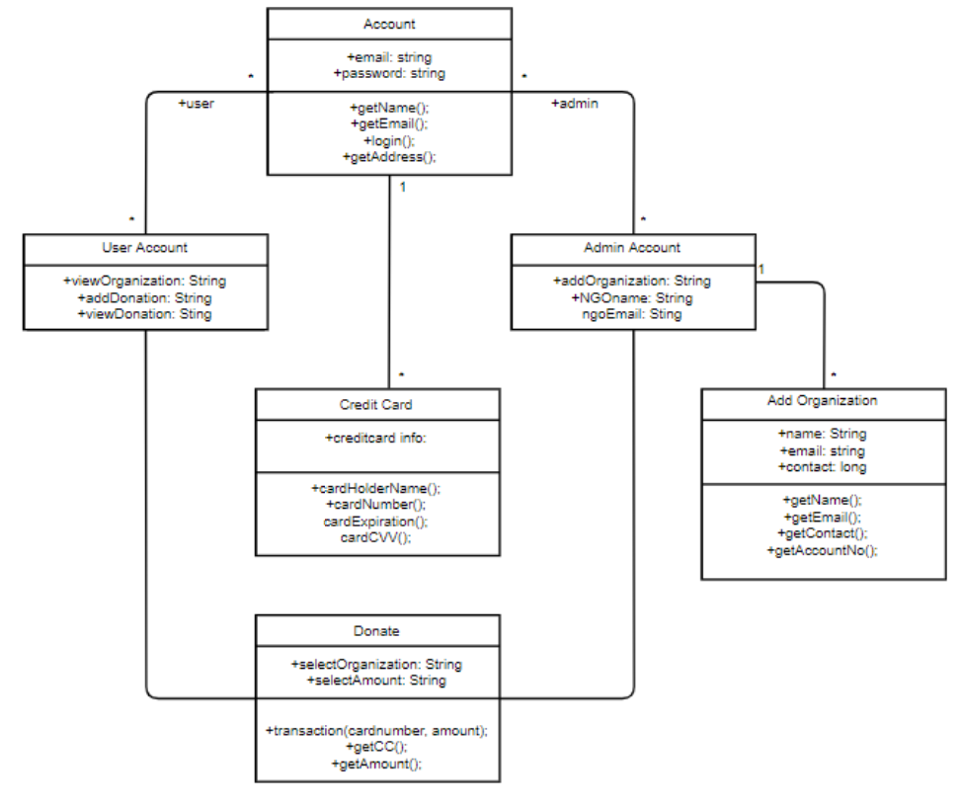
Class Diagram

Slide 15
Proposed System Functionalities
The system will contain these functionalities:
Sign up and Sign in.
Pick an organization of their choice.
Amount of money they want to donate.
Choose the Payment Method.
Make the payment.

Slide 16
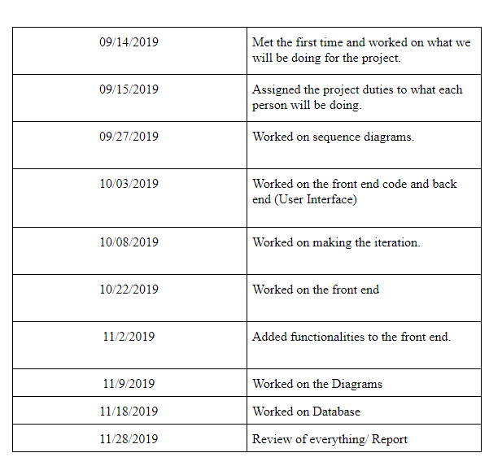
Project Log

Slide 17
Project Plan
In each iteration we will try to display our functionalities that we have completed by that time and discuss what each person will be doing during the course of this project and who will be the incharge of what.
Also adding more functionalities along time to make this application easier to use for users.

Slide 18
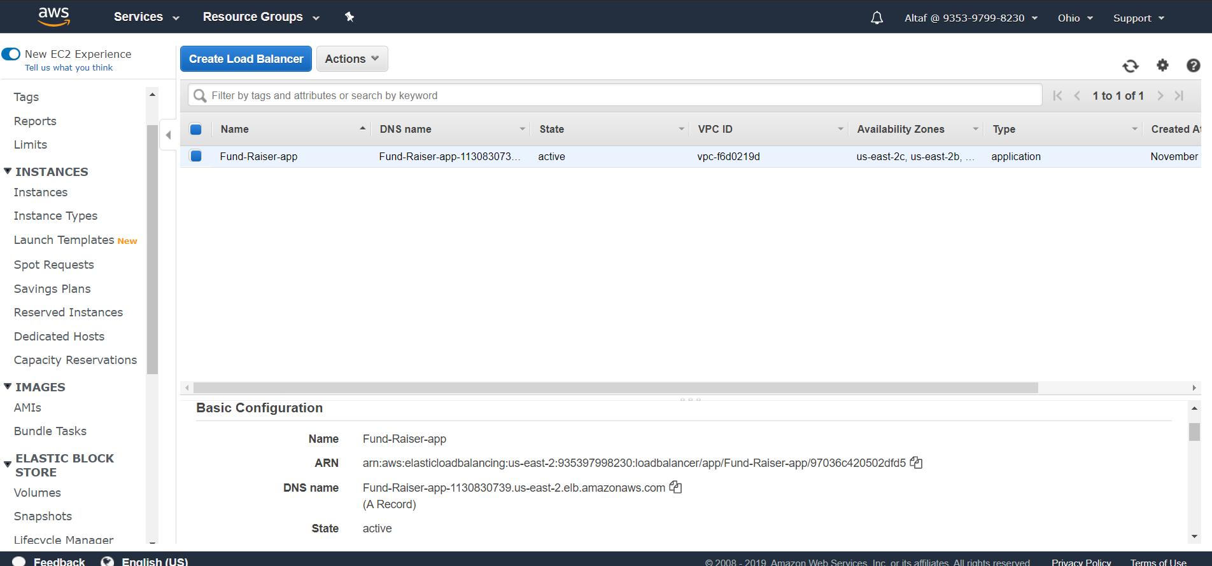
AWS Deployment URL:Fund-Raiser-app-1130830739.us-east-2.elb.amazonaws.com

